Slide 1


Machine Learning in Physics: From solving PDEs to developing better theories
Notes:
Title: Machine Learning in Physics: From solving PDEs to developing better theories
Abstract: Machine Learning has had a significant impact on a variety of application domains such as computer vision and natural language processing, and has now matured enough so it can impact more complex scientific problems in physics. In this talk, I will discuss using ML towards solving a variety of physics problems ranging from fluid-dynamics PDE solving with neural networks, optimizing Hamiltonians from condensed matter applications to searching for better theoretical formulas that match existing observations.

Slide 2
Outline
Part 1: Supervised learning for scientific problems
Part 2: Solving PDEs with NNs
Part 3: Physics-inspired AI models
Part 4: Neural network potentials
Part 5: AI models for learning new physics theories
Part 6: Can can ML help your research field? Use cases in superconductivity

Slide 3
Part 1
Supervised learning for scientific problems

Slide 4
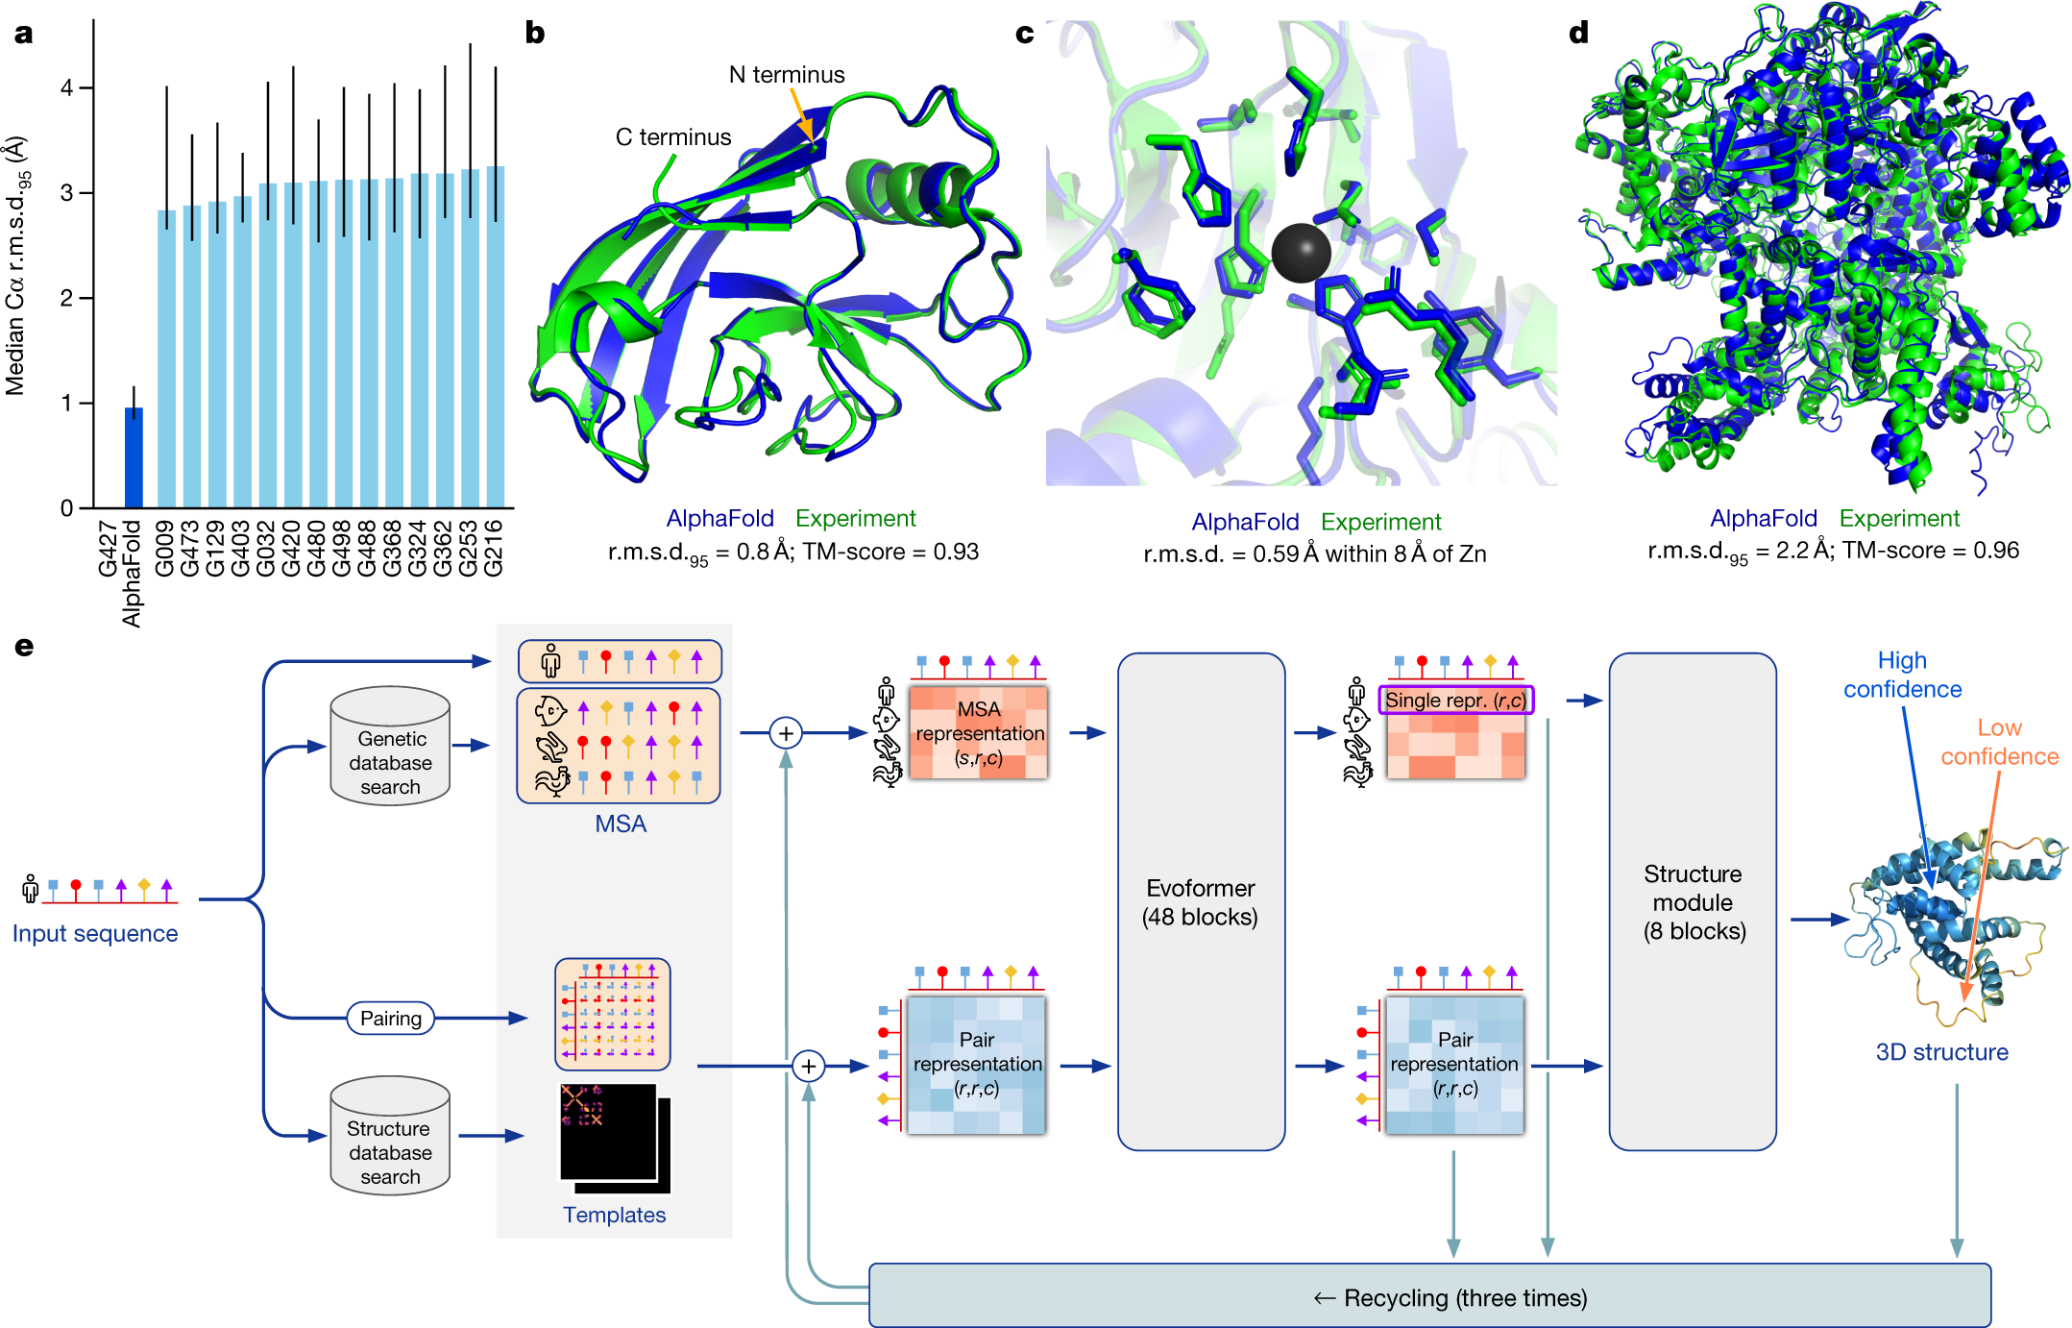
AlphaFold
First computational model to achieve highly-accurate protein folding
Nobel prize 2025
DL + MSA + physics-based model
Relied on 150k+ protein structures from the PDB

Slide 5
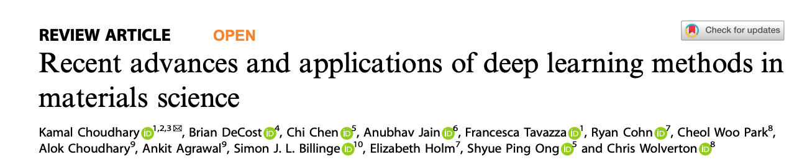
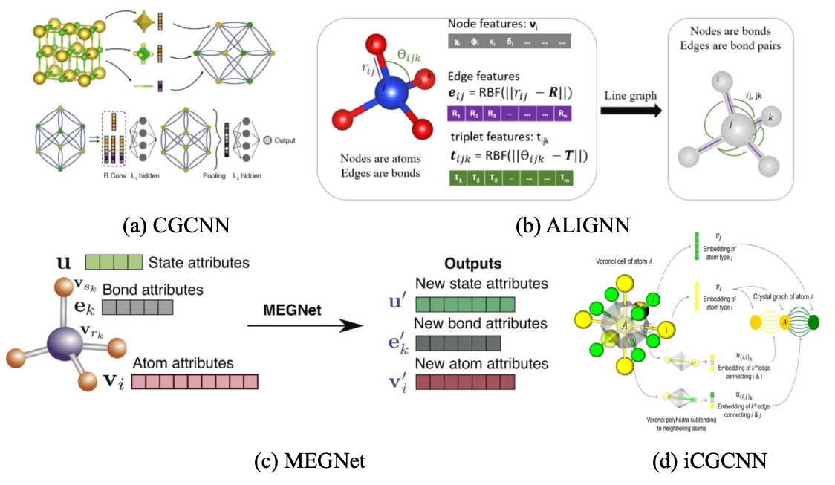
ML in Materials science
Fast Material screening
Direct property predictions:
  formation energies
  electronic bandgaps
  dielectric constants
  elastic modulus
  …
  Often obtained from ab-initio simulations
Force-field development
Challenges:
  input data needs to be fixed size
  Graph neural networks are more difficult to work with
Notes:
Recent advances and applications of deep learning methods in materials science - https://www.nature.com/articles/s41524-022-00734-6.pdf
Fig. 2 Schematic representations of an atomic structure as a graph. a CGCNN model in which crystals are converted to graphs with nodes representing atoms in the unit cell and edges representing atom connections. Nodes and edges are characterized by vectors corresponding to the atoms and bonds in the crystal, respectively [Reprinted with permission from ref. 67 Copyright 2019 American Physical Society], b ALIGNN65 model in which the convolution layer alternates between message passing on the bond graph and its bond-angle line graph. c MEGNet in which the initial graph is represented by the set of atomic attributes, bond attributes and global state attributes [Reprinted with permission from ref. 33 Copyright 2019 American Chemical Society] model, d iCGCNN model in which multiple edges connect a node to neighboring nodes to show the number of Voronoi neighbors [Reprinted with permission from ref. 122 Copyright 2019 American Physical Society].

Slide 6
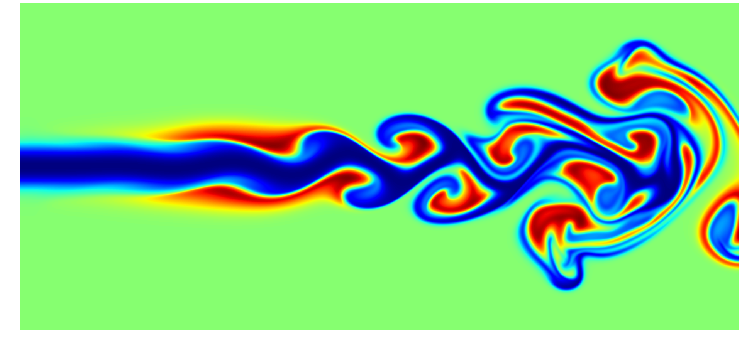
Part 2
Solving Physics PDEs with neural networks

Slide 7
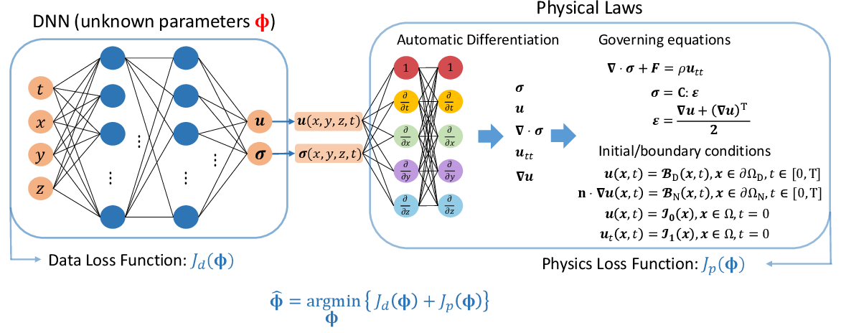
Physics-informed Neural Networks
Raissi et al, 2019, Journal of Computational Physics
data loss
physics loss
Notes:
https://medium.com/@hridaym.211me129/hands-on-physics-informed-neural-networks-2e9bca75ab59

Slide 8
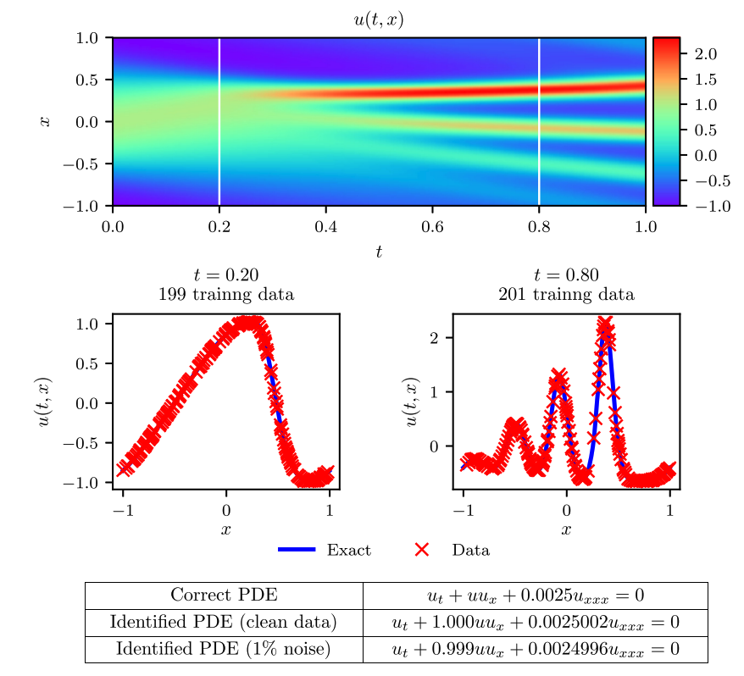
Physics-informed Neural Networks
Raissi et al, 2019, Journal of Computational Physics
Korteweg–de Vries (KdV) equation (waves on shallow water surfaces)
Neural net can find numerical solution
Obeys both physics laws and observations u(x_{i},t_{i})
Notes:
Our final example aims to highlight the ability of the proposed framework to handle governing partial differential equations involving higher order derivatives. Here, we consider a mathematical model of waves on shallow water surfaces; the Korteweg–de Vries (KdV) equation. This equation can also be viewed as Burgers equation with an added dispersive term. The KdV equation has several connections to physical problems. It describes the evolution of long one-dimensional waves in many physical settings. Such physical settings include shallow-water waves with weakly non-linear restoring forces, long internal waves in a density-stratified ocean, ion acoustic waves in a plasma, and acoustic waves on a crystal lattice. Moreover, the KdV equation is the governing equation of the string in the Fermi–Pasta–Ulam problem [48] in the continuum limit. The KdV equation reads as
ut + λ1uux + λ2uxxx = 0, (27)
with (λ1, λ2) being the unknown parameters. For the KdV equation, the nonlinear operator in equations (22) is given by
N [un+c j] = λ1un+c j u n+c j x − λ2u n+c j xxx
and the shared parameters of the neural networks (23), (24), and (25) along with the parameters λ = (λ1, λ2) of the KdV equation can be learned by minimizing the sum of squared errors (26). To obtain a set of training and test data we simulated (27) using conventional spectral methods. Specifically, starting from an initial condition u(0, x) = cos(πx) and assuming periodic boundary conditions, we have integrated equation (27) up to a final time t = 1.0 using the Chebfun package [40] with a spectral Fourier discretization with 512 modes and a fourth-order explicit Runge–Kutta temporal integrator with time-step t = 10−6. Using this data-set, we then extract two solution snapshots at time t n = 0.2 and t n+1 = 0.8, and randomly sub-sample them using Nn = 199 and Nn+1 = 201 to generate a training data-set. We then use these data to train a discrete time physics-informed neural network by minimizing the sum of squared error loss of equation (26) using L-BFGS [35]. The network architecture used here comprises of 4 hidden layers, 50 neurons per layer, and an output layer predicting the solution at the q Runge–Kutta stages, i.e., un+c j(x), j = 1,..., q, where q is empirically chosen to yield a temporal error accumulation of the order of machine precision by setting4 q = 0.5 log / log(t),

Slide 9
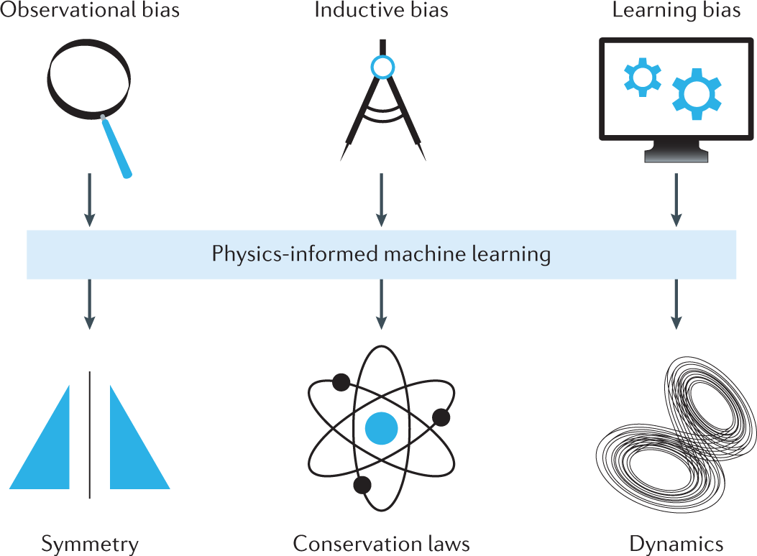
Part 3
Physics-inspired
AI models

Slide 10
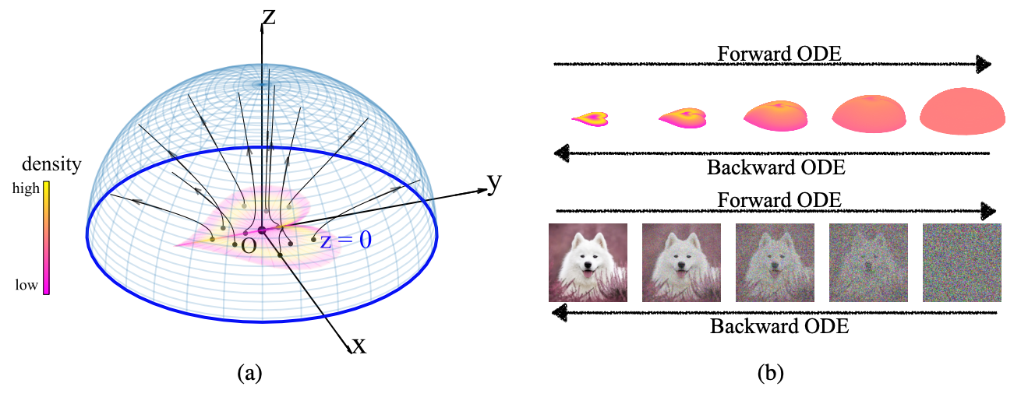
Poisson Flow Generative Models
Xu, 2022, NeurIPS 2022

Slide 11
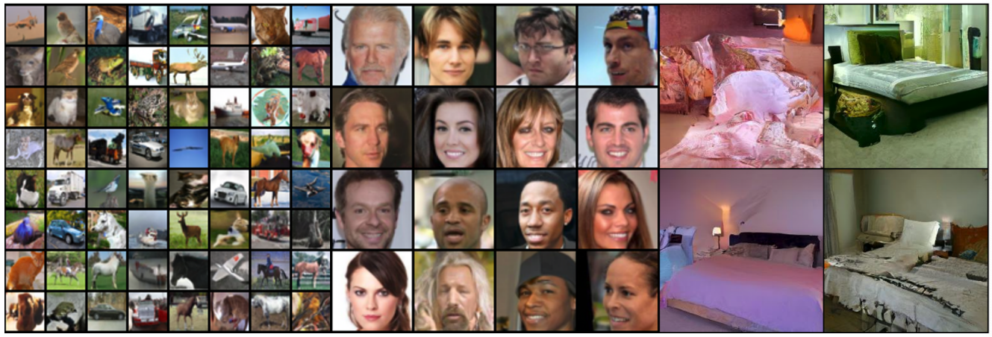
Poisson Flow Generative Models
Xu et al, NeurIPS 2022

Slide 12
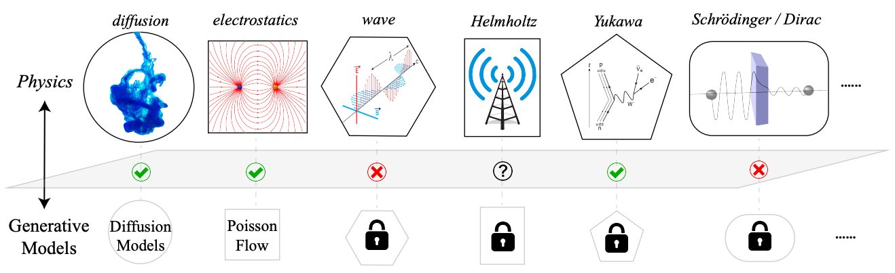

GenPhys: Generative Models from Physical Processes
Liu et al, CoRR 2023
Conditions:
PDE is equivalent to a density flow:
Density flow is smooth and has a steady state
Notes:
https://arxiv.org/pdf/2304.02637

Slide 13
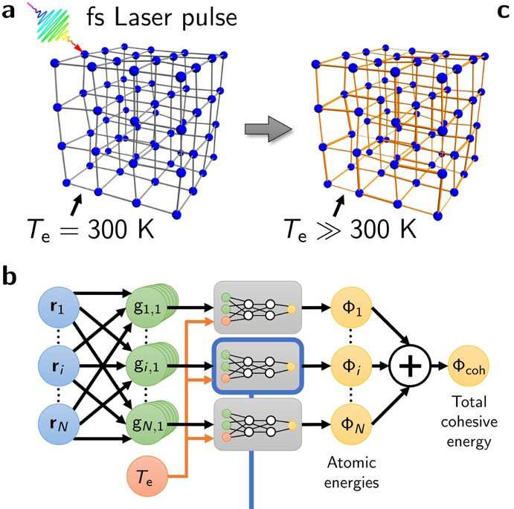
Part 4
NN potentials
=
Using neural networks to learn energy functions

Slide 14
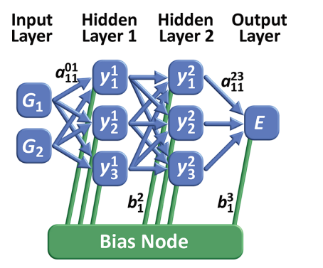
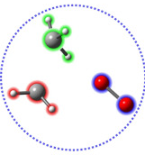
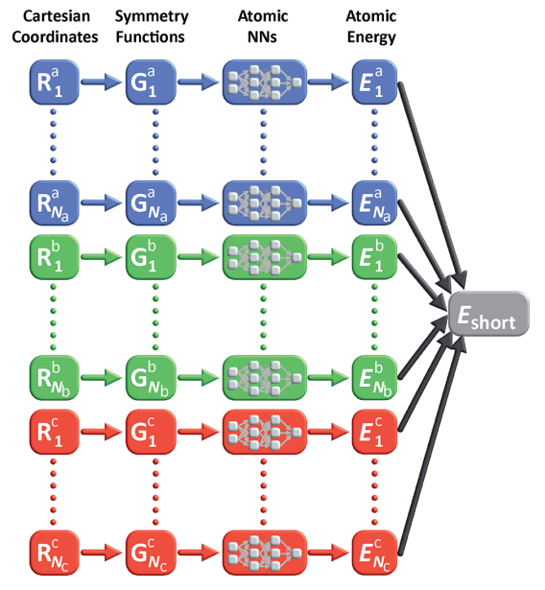
Neural Net potentials
Behler, Chem Rev 2021
Used as force fields in Molecular Dynamics
Significantly faster than classical force fields
First gen: simple feed-forward MLPs on small atomic systems
Second gen:
  atom-wise energy contributions are summed up
  Atom environment described by atom-centered symmetric functions
  Rotational, translational and permutation invariance
First-generation
Second generation
Notes:
https://pubs.acs.org/doi/pdf/10.1021/acs.chemrev.0c00868 - Four Generations of High-Dimensional Neural Network Potentials

Slide 15
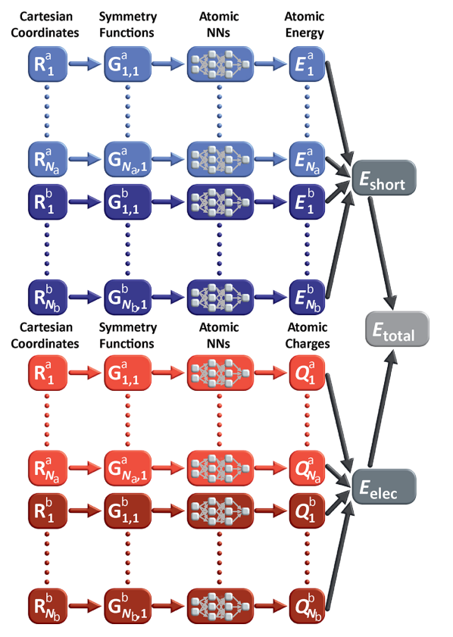
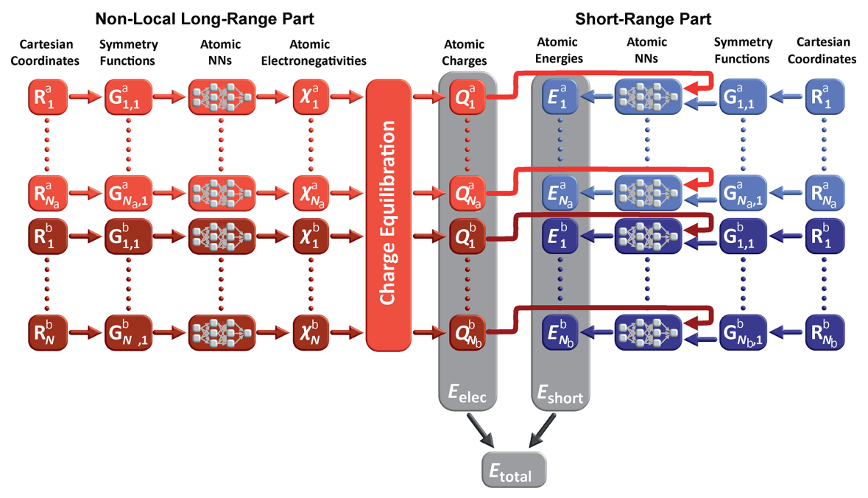
Neural Net potentials
Behler, Chem Rev 2021
Third gen: long-range interactions also modelled employing partial changes
Fourth gen: + non-local phenomena, i.e. long-range charge transfer modelled
Third generation
Fourth generation
Notes:
https://pubs.acs.org/doi/pdf/10.1021/acs.chemrev.0c00868 - Four Generations of High-Dimensional Neural Network Potentials

Slide 16
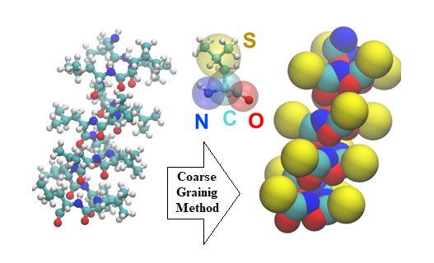
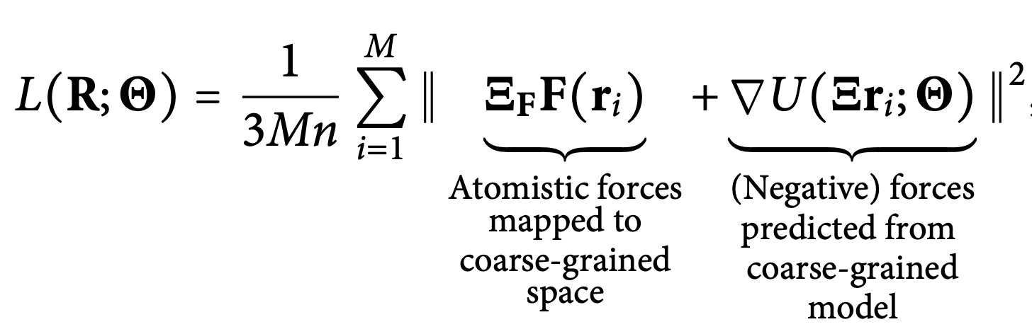
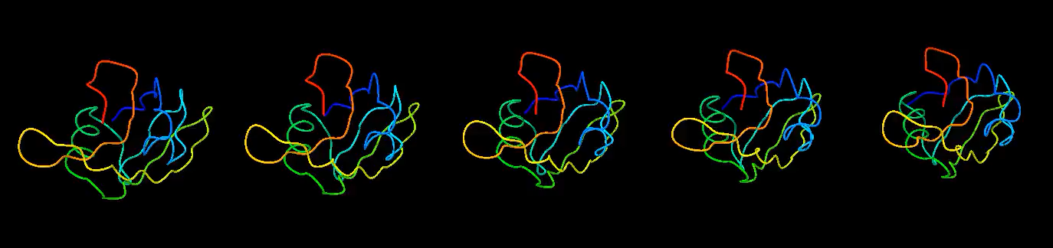
Our research: using NN potentials to speed-up Molecular Dynamics
We coarse-grained proteins to C_{α} beads
We learn a NN potential in the CG space
We train the model with force matching:
MD simulations 30X-600X faster using the NN potential

Slide 17
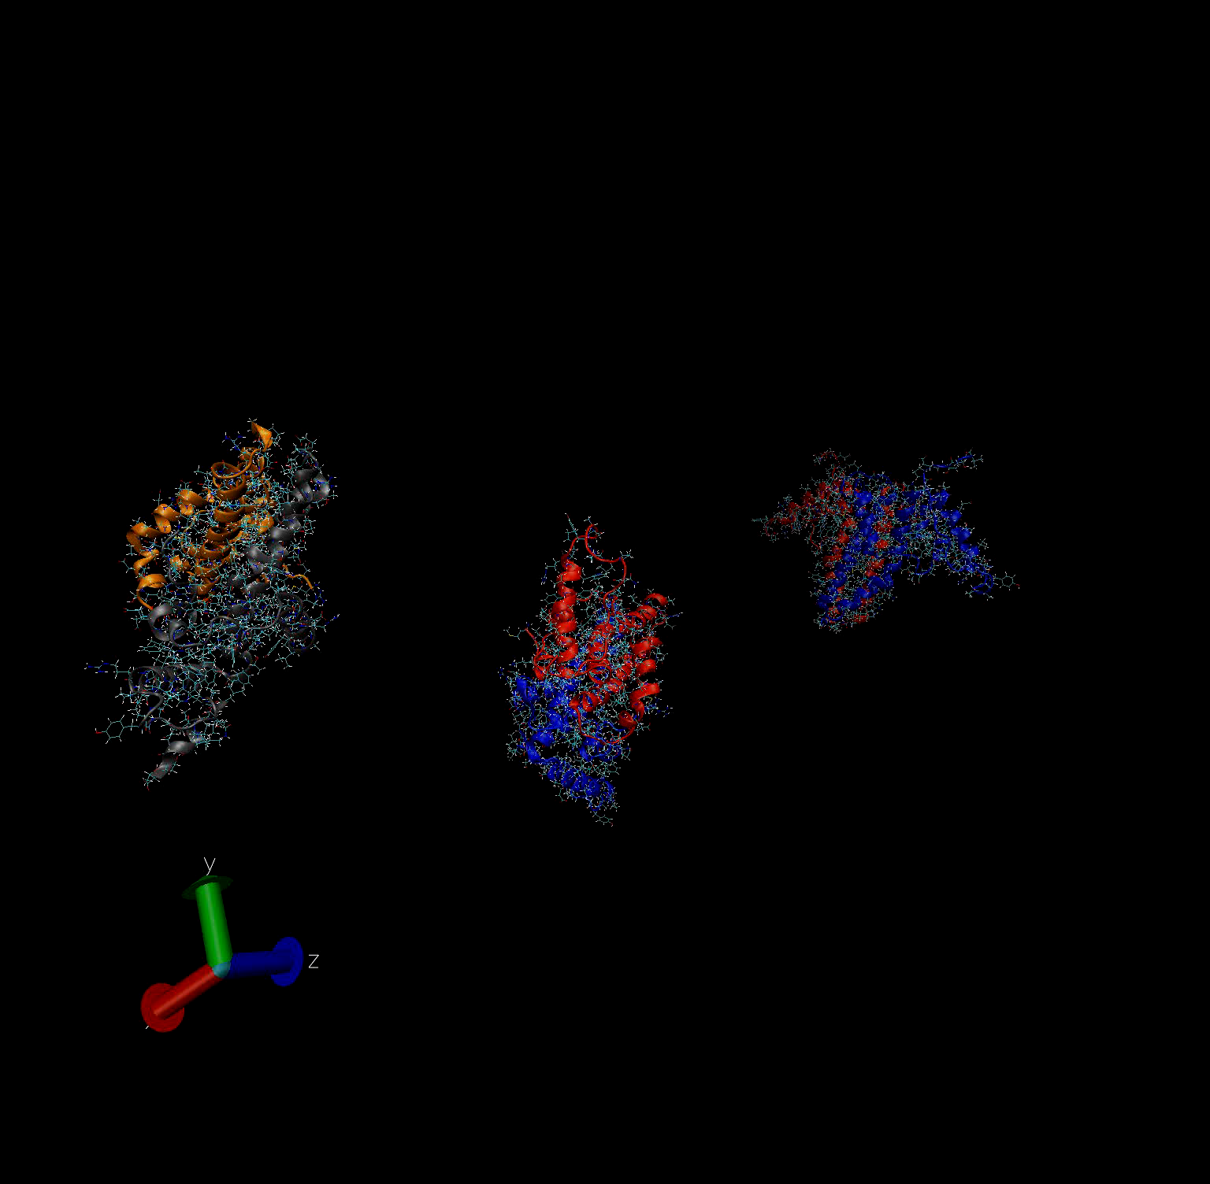
Next: use NN potentials to simulate long biological processes
Protein-protein and protein-ligand attachment can take ~ 10⁻⁶ to 10⁻³ s
Simulating the attachment of 3 dimers (12k atoms) took 3 days on 200 GPUs
With NN potentials, this can take less than 45min

Slide 18

Simulation of the self-assembly of the Hepatitis B virus

Slide 19
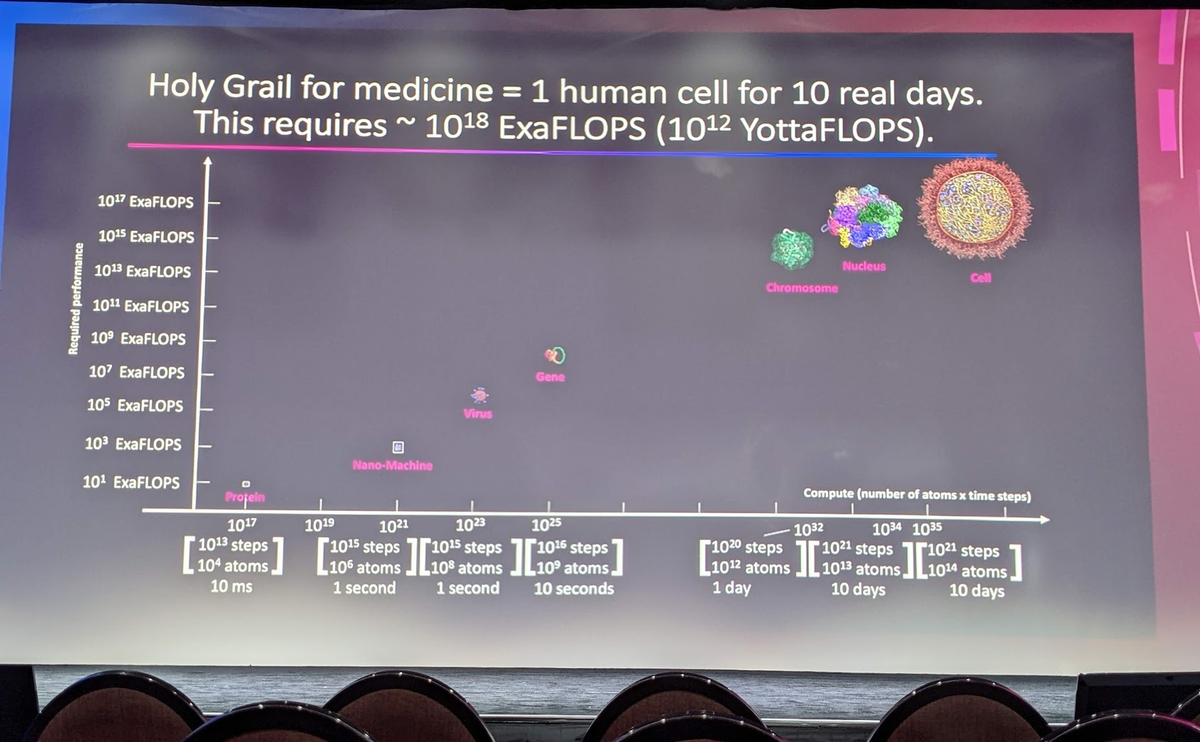

Slide 20
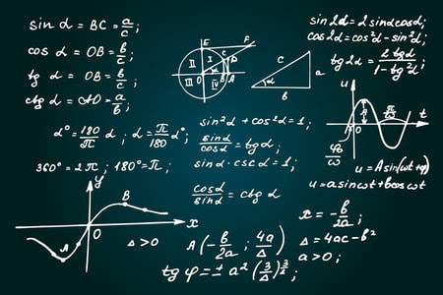
Part 5
AI models for learning new physics theories

Slide 21
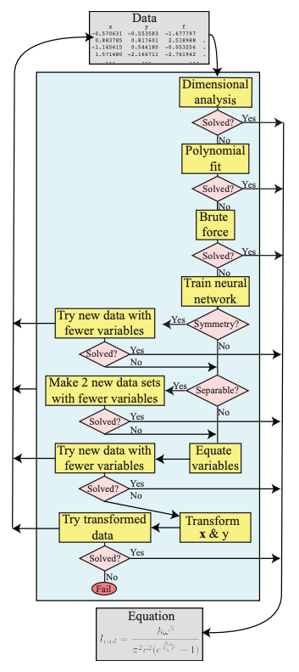
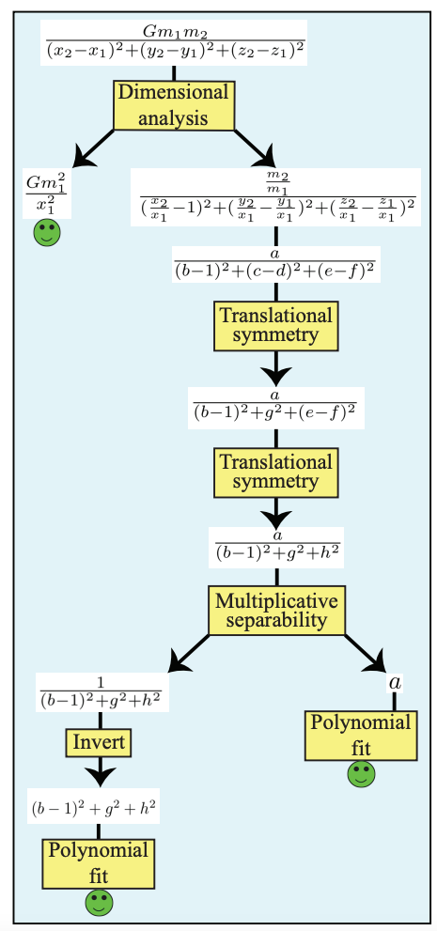
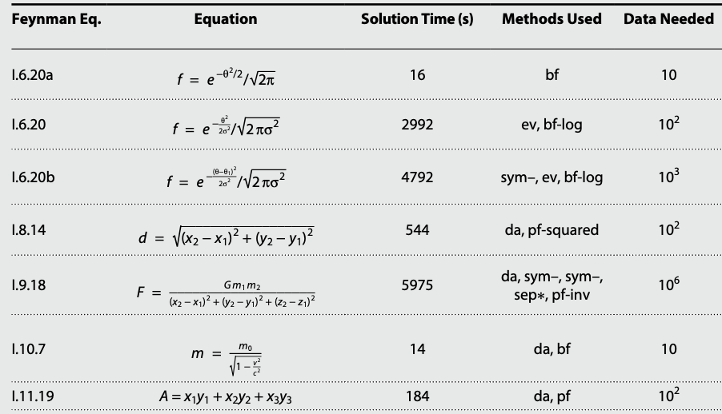
AI Feynman
Urdescu and Tegmark, Sci. Adv 2020
Used symbolic regression to match data from unknown functions
Discovered all 100 equations from the Feynman Lectures on Physics

Slide 22
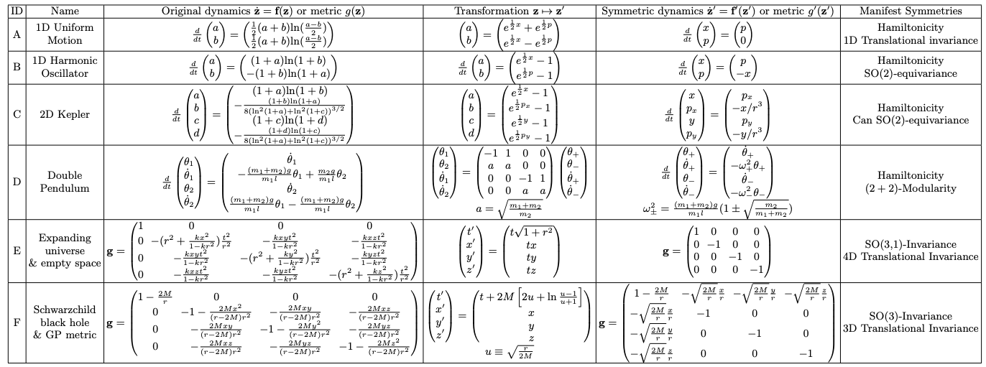
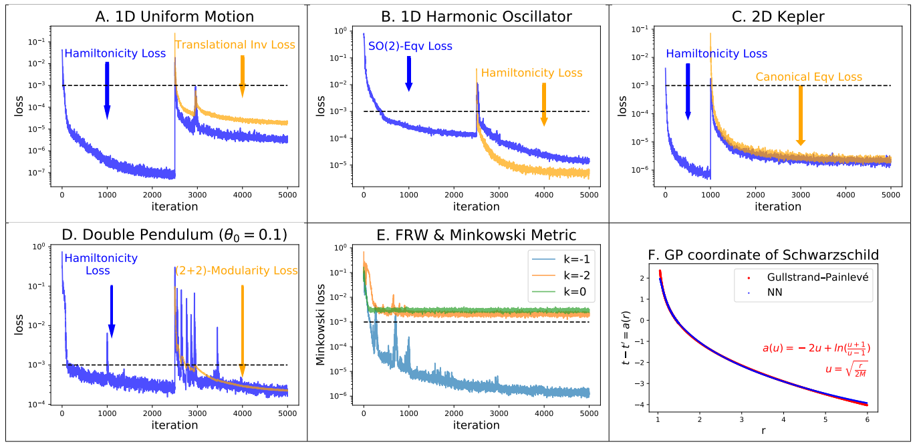
Machine Learning Hidden Symmetries
Liu and Tegmark, Phys. Rev. Lett., 2022
Philip Anderson: “It is only slightly overstating the case to say that physics is the study of symmetry”
Some symmetries become manifest only after appropriate coordinate transformations
Idea: quantify asymmetry as violation of certain PDEs
Numerically search for transformations that minimize such violations
Notes:
https://link.aps.org/accepted/10.1103/PhysRevLett.128.180201

Slide 23
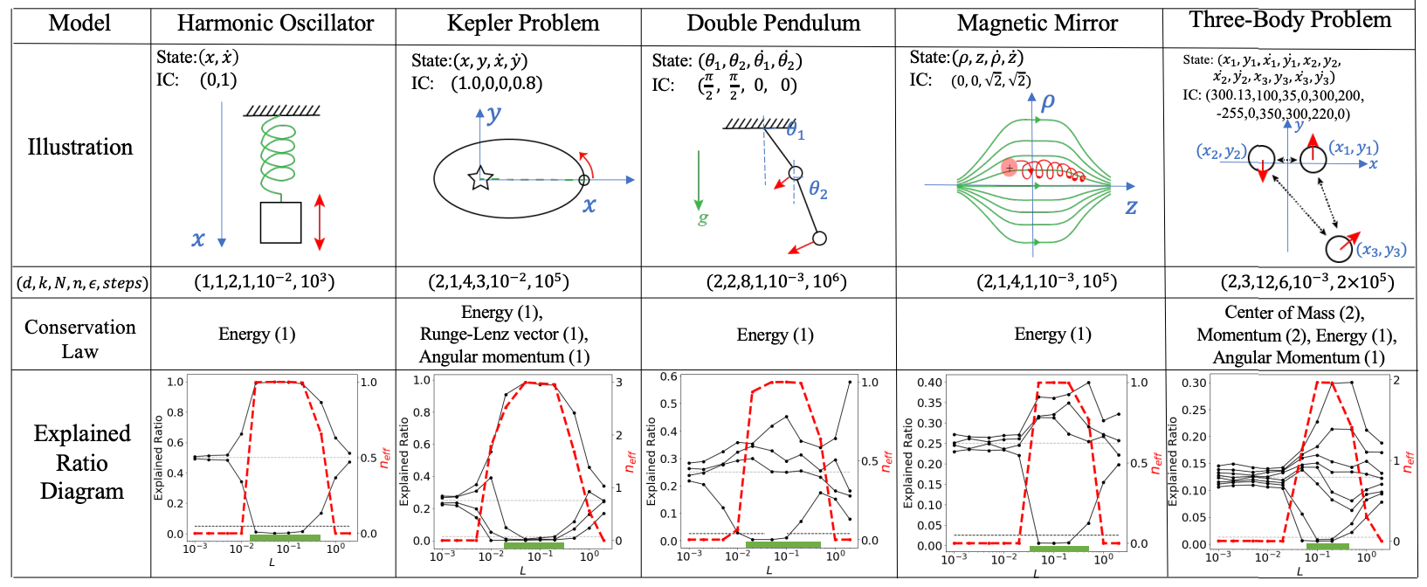
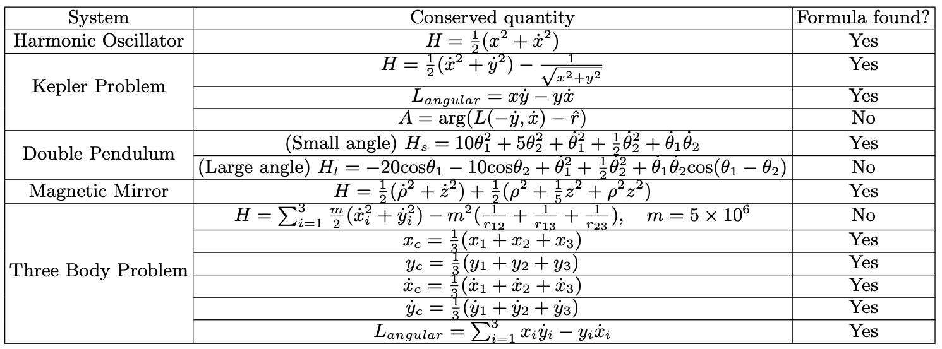
Machine Learning Conservation Laws from Trajectories
Liu and Tegmark, Phys. Rev. Lett., 2021
Input: trajectory data from different dynamical systems
Output: Conserved quantities
Tested on five Hamiltonian systems
ML model discovered not only exactly conserved quantities, but also periodic orbits and phase transitions
Notes:
https://link.aps.org/accepted/10.1103/PhysRevLett.126.180604

Slide 24
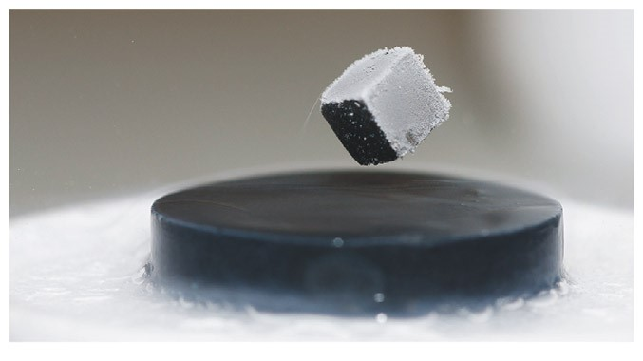
Part 6
How can ML help your research field?
Use cases in Superconductivity

Slide 25
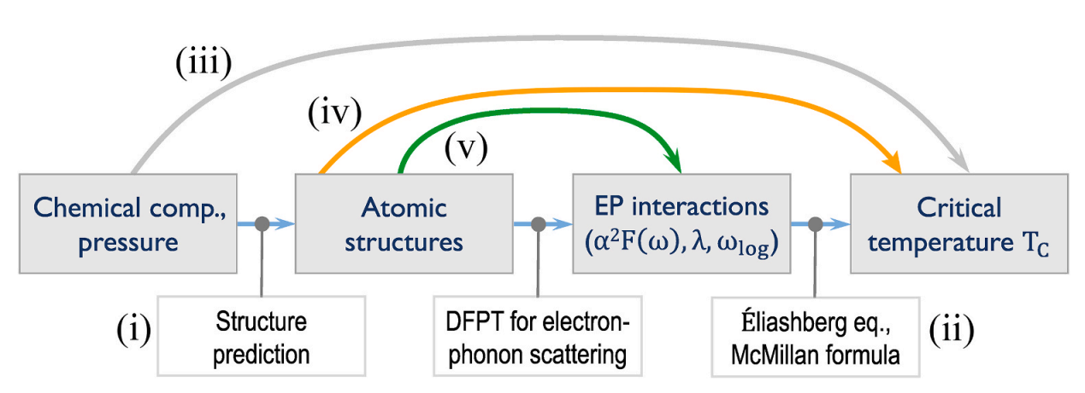
ML can help predict T_{c} at different levels
Advantages:
More flexible functions than classical models
Speed
Disadvantages:
Need data
Hard to generalize to new material phases
Can combine ML + classical physics
Bai et al, 2024, Materials Today Physics
Notes:
Unveiling future superconductors through machine learning - https://www.sciencedirect.com/science/article/pii/S2542529324000609

Slide 26
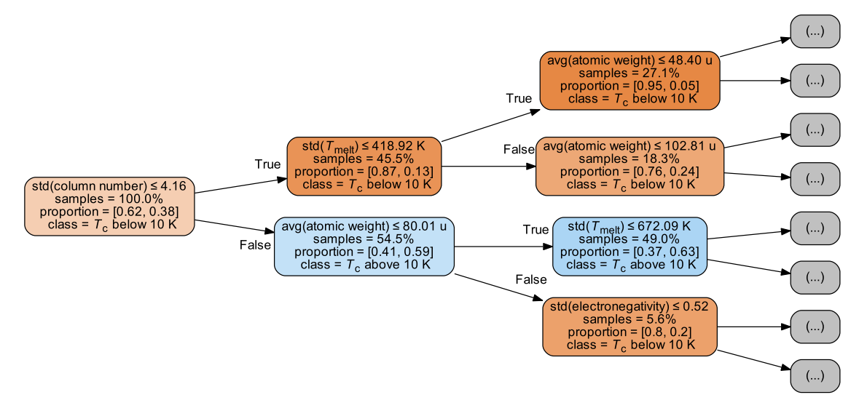
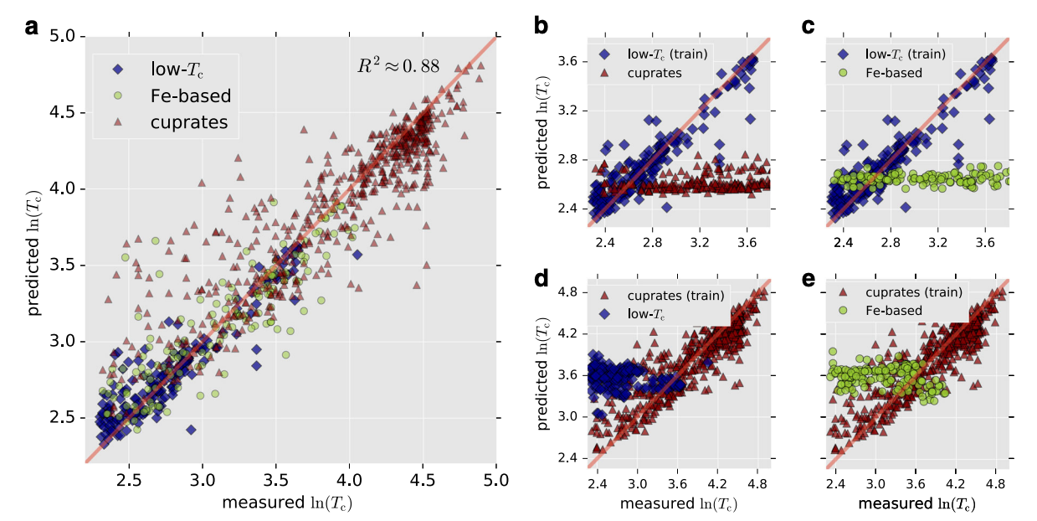
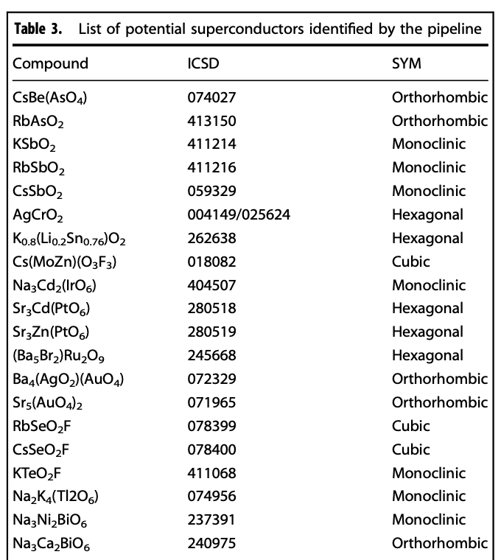
Supervised ML prediction of Superconducting critical temperature
Stanev et al, NPJ Comp Materials, 2018
Uses 145 extracted features: stoichiometric features, stats of elemental properties (=atomic number, radii, melting temp), electronic structure (s,p,d,f, shells)
Model can predict accurately but only if training data contained superconductors of that class
Used Random Forests as the ML predictor
Notes:
https://www.nature.com/articles/s41524-018-0085-8

Slide 27
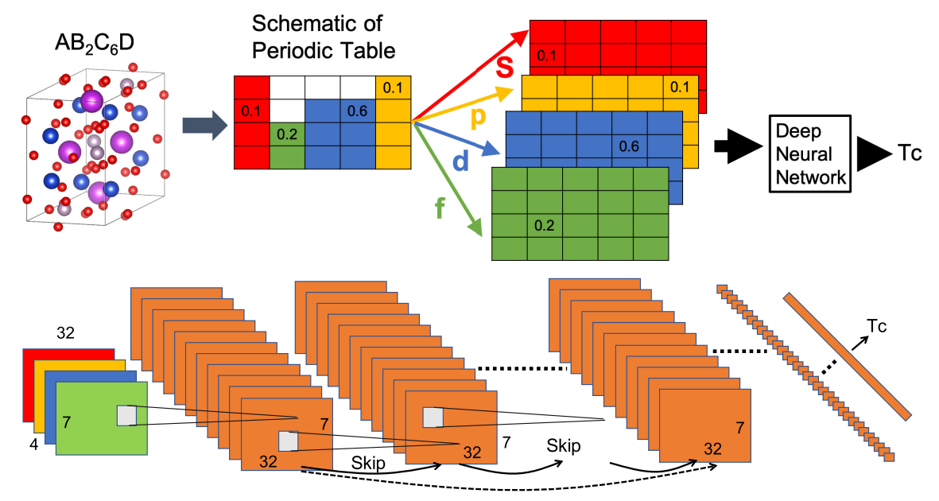
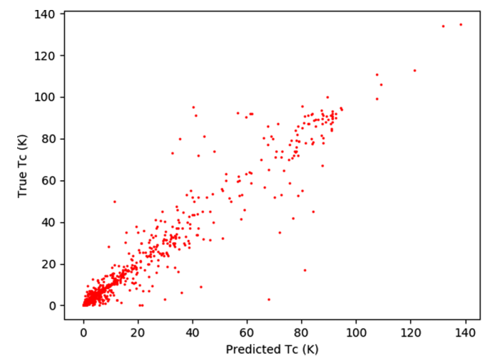
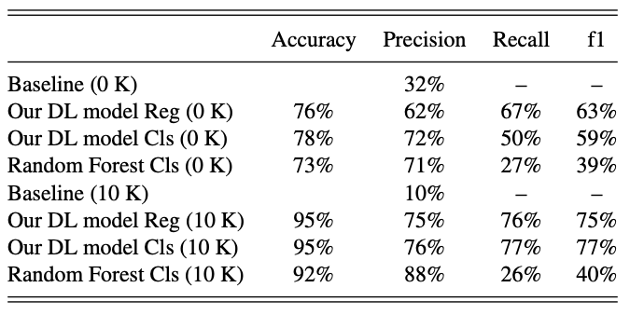
Deep Learning prediction of T_{c} from atomic structure
Konno et al, Phys Rev 2021
Uses Deep Learning which can be a better function approximator when given large datasets
Atomic structure -> T_{c}
Notes:
https://journals.aps.org/prb/pdf/10.1103/PhysRevB.103.014509

Slide 28
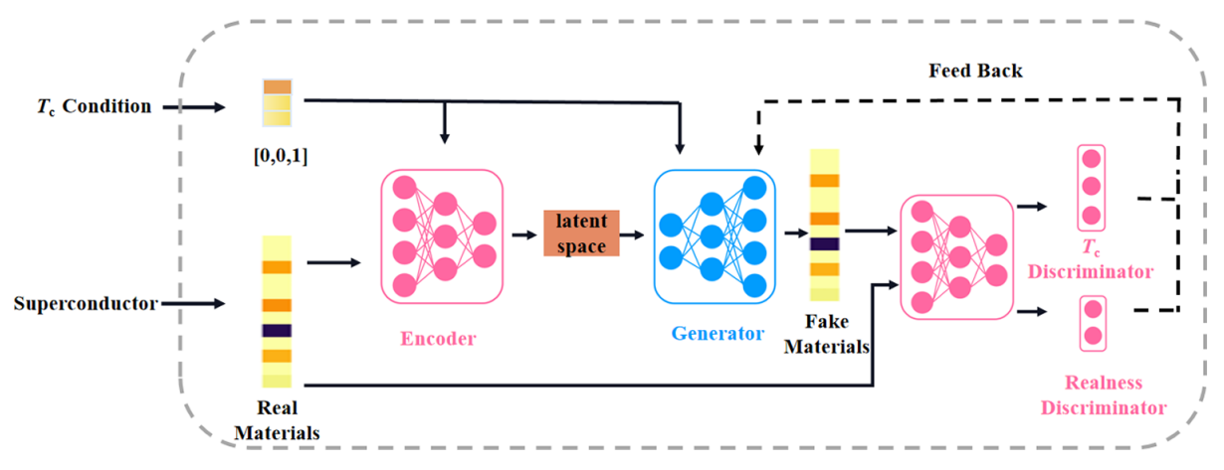
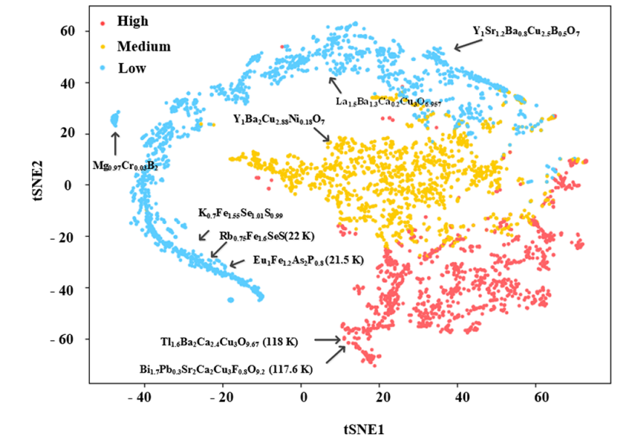
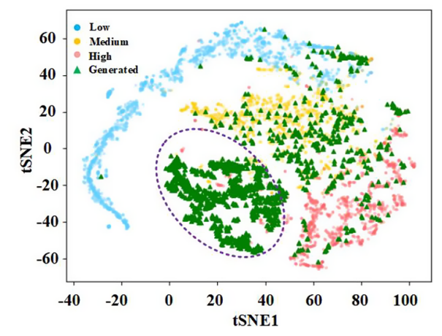
Inverse Design of High-Tc Superconductors using Deep Learning
Zhong et al, ACS Applied Mat. 2023
Learned a latent space of materials
Can interpolate/extrapolate in latent space to get a new latent
New latent can be decoded into a new material
Used a Generative Adversarial Network + additional encoder
Notes:
https://pubs.acs.org/doi/pdf/10.1021/acsami.3c00593

Slide 29
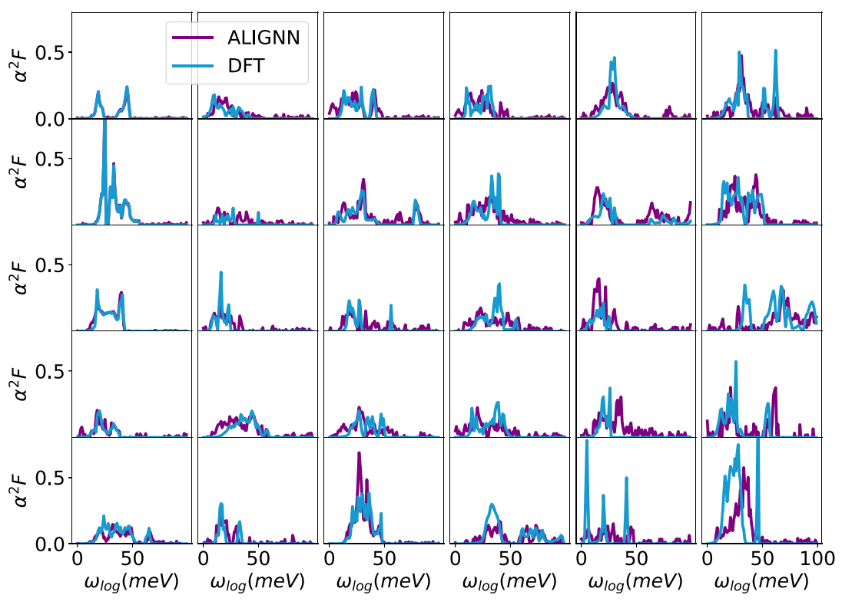
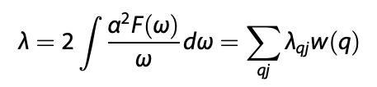
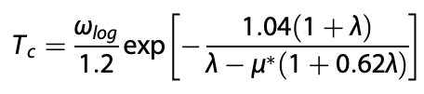
No need to predict Tc directly. Can combine ML + classical models
Choudhary et al, NPJ Comp Mat 2022
24% improvement by predicting the Eliashberg functions instead of Tc directly
The ML-predicted Eliashberg functions are then used to compute the EPC parameters λ
λ is used to predict T_{c} using the McMillan–Allen–Dynes formula
Notes:
https://www.nature.com/articles/s41524-022-00933-1.pdf

Slide 30
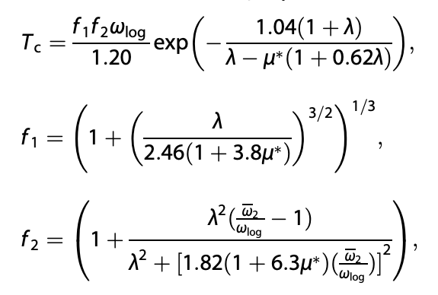
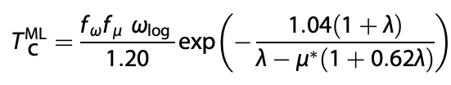
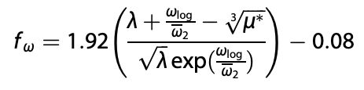
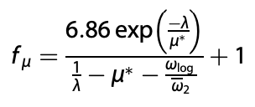
Correcting existing theoretical models with ML
Xie et al, NPJ Comp Mat 2022
Corrected the McMillan-Allen-Dynes formula using symbolic regression
The correction also works in the strong-coupling limit λ → ∞
Classical McMillan-Allen-Dynes formula
ML-derived correction
Notes:
https://www.nature.com/articles/s41524-021-00666-7

Slide 31
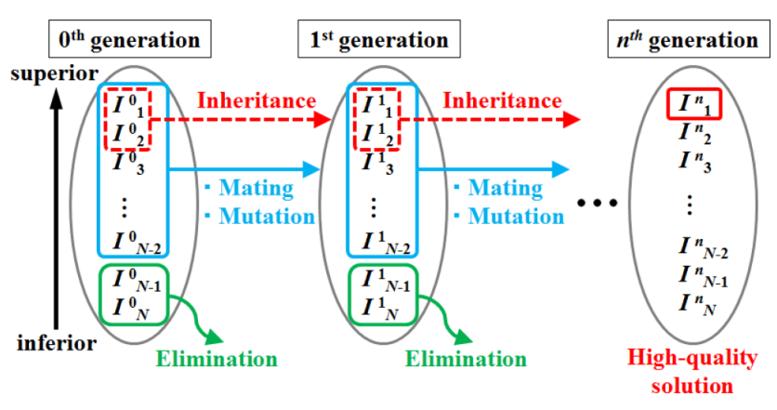
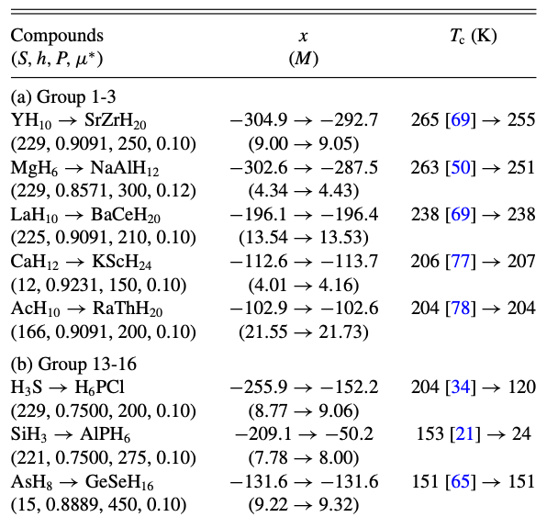
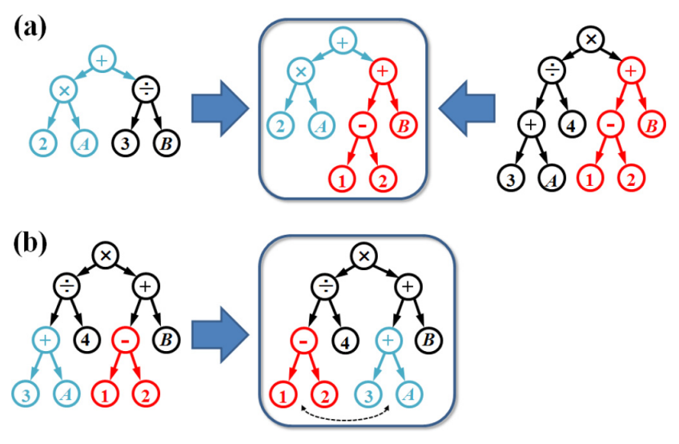

Superconductivity of ternary compounds with genetic algorithms
Ishikawa et al, Phys Rev 2019
Mating
Mutation
Notes:
https://journals.aps.org/prb/pdf/10.1103/PhysRevB.100.174506

Slide 32


ML-based Superconductivity of hydrides
Hydrides of heavy alkali and alkaline earth metals are most promising for attaining superconductivity
Notes:
https://journals.aps.org/prb/pdf/10.1103/PhysRevB.101.144505

Slide 33
Conclusion
ML can help fit more flexible functions
NN potentials can help speed-up classical simulations
ML can be used when:
  we don’t have classical functional forms
  we want to reduce degrees of freedom
Use neural nets if you need derivatives and smoothness
Should my ML model use the crystal structure? Yes, see Zhang 2022, +20% performance boost
Material screening workflow
Theory
ML
Cost
Classical models
Empirical testing

